Slide 1
ONLINE JOB SEARCH
Prepared by:
Vishnu priya.S
Deepika.B
Chithra Banu.V
Sofia.M
Vaishnavi.A
Keerthana.R

Slide 2
ABSTRACT
Online job searching is one of the large commercial and informative website providing its services to all kinds of people.Major functionalities of the site include providing services to recruitment agencies,software and hardware development companies,job seekers and e-learners.
Once job providers register with the site,giving the details about their companies,they can achieve the services like getting the resumes of job seekers,placing the job advertisement for the people with specific skills and also advertise about company and products they have developed.Job seekers can search for the jobs by giving the queries and getting the information.

Slide 3
INTRODUCTION
In this portal different organizations,institutions etc.display/advertise jobs according to their requirements so that the people or job seekers view the different kind of jobs and the further information about the related organization.Organizations also check the CV’s of job seekers if he/she fulfill the requirements of the organizations,it hire’s or contact them for the jobs.

Slide 4
PURPOSE
The purpose of designing the online job portal is to give the job seekers platform for finding a right and a satisfactory job according to their qualification.It also connects the job seekers with the major organizations.

Slide 5
SCOPE
The scope of the online job portal includes:
The Online job Portal System that is to be developed provides the members with jobs information,online applying for jobs and many other facilities.The basic scope of the project is given as under.
Employee/Job seekers
Employee/Job provider
Admin of site
Admin of company

Slide 6
MAIN MODULE
Job Provider
Job Seekers
E-Learners
Job Provider
Job Providers register with the site by giving the details about their company,they can achieve the services like getting the resumes of job seekers,placing the job advertisement about company and products they have developed.

Slide 7
Job Seekers
The Job Seekers can search for the jobs by giving the queries and get the information and they will have access to all the services like advanced job search,employment news and FAQ’s.They can also have the access to the practice test for technical and general interviews.

Slide 8
E-Learners
The feature of E-Learners is much like the e-Learning.The e-learners need not register with the site and they can have access to e-learning.This service provides the features like online examples,online lessons,online exercise.

Slide 9
SOFTWARE INTERFACE
Front End Client:
Html
Web Server:
WASCE
Data Base Server:
DB2
Back End:
Python

Slide 10
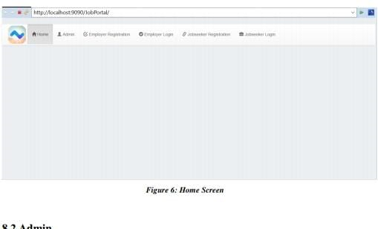
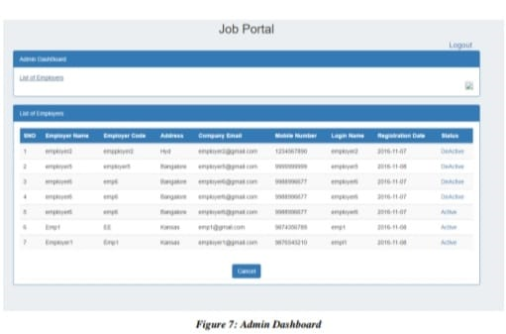
SCREENSHOTS

Slide 11
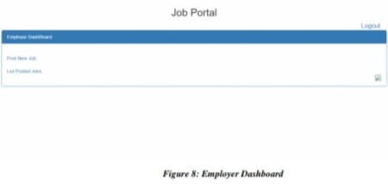
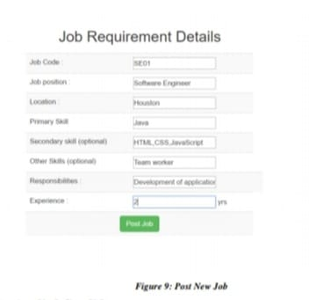

Slide 12
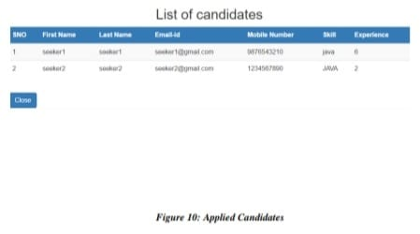
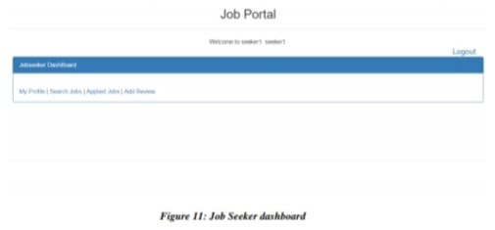

Slide 13
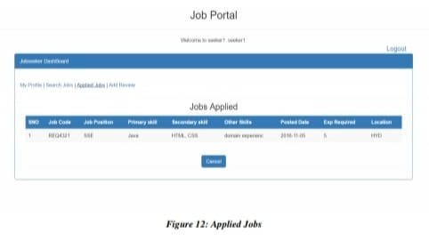
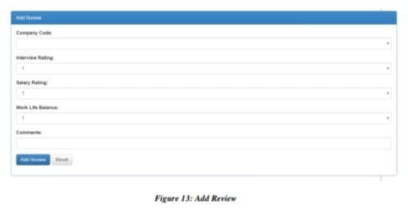

Slide 14
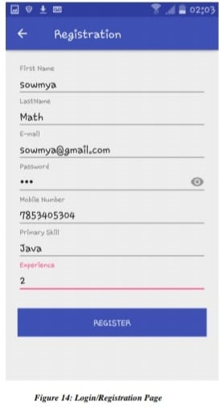
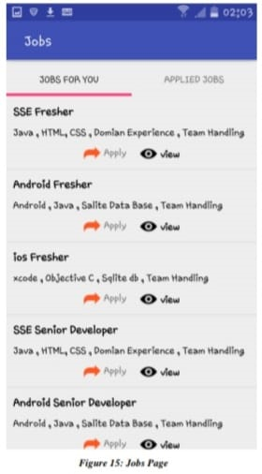

Slide 15
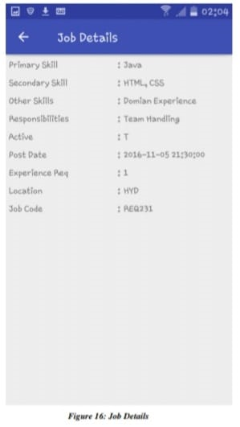
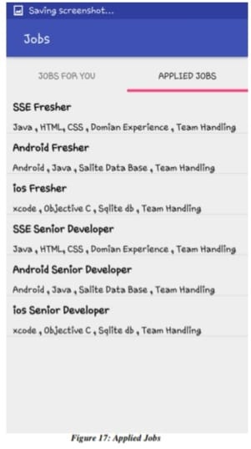

Slide 16
THANK YOU

